Slide 1
OSI Network Layer
IPv4 Subnetting

Slide 2
Because the fast deployment of internet, the IP addresses become not enough

Slide 3
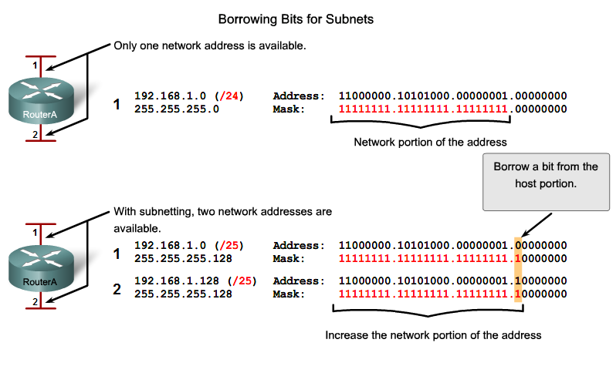
Subnetting

Slide 4
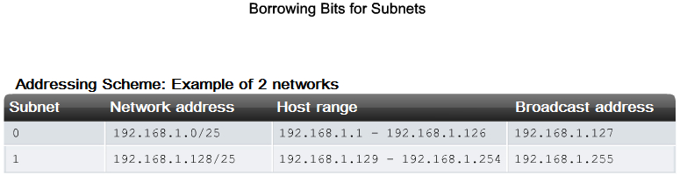
Subnetting

Slide 5
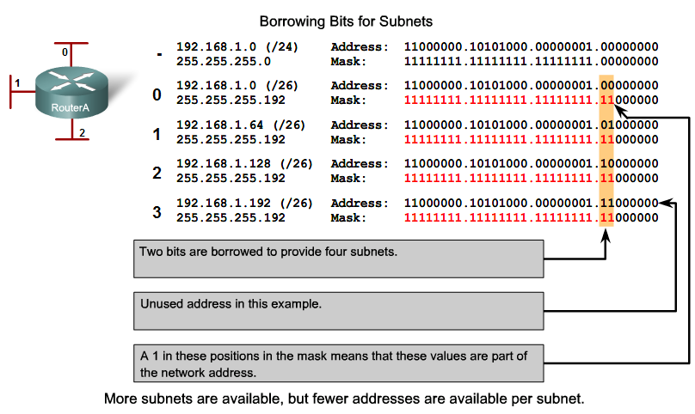
Subnetting

Slide 6
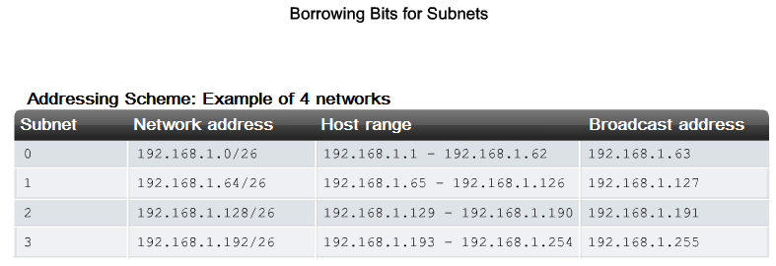
Subnetting

Slide 7
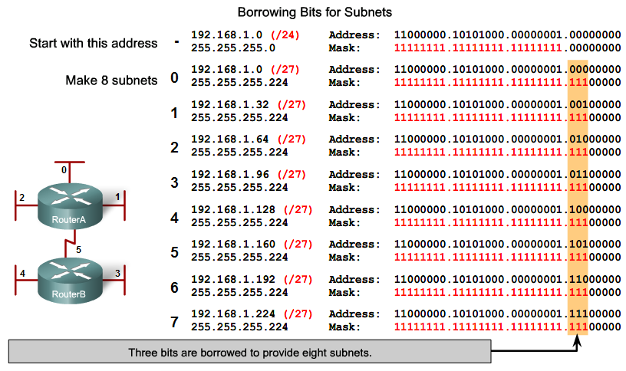
Subnetting

Slide 8
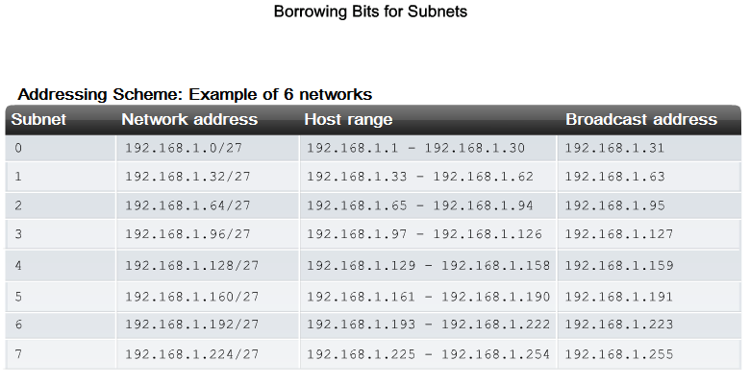
Subnetting

Slide 9


- Which IP address should be assigned to PC B ?
Subnetting Example
A . 192.168.5.5
B . 192.168.5.32
C . 192.168.5.40
D . 192.168.5.63
E . 192.168.5.75
A
B
192.168.5.33/27
?
Answer : C

Slide 10
- Given the choices below, which address represents a unicast address?
Subnetting Example
A . 224.1.5.2
B . FFFF. FFFF. FFFF.
C . 192.168.24.59/30
D . 255.255.255.255
E . 172.31.128.255/18
Answer : E

Slide 11
Test a connectivity
Ping is a utility for testing IP connectivity between hosts. Ping sends out requests for responses from a specified host address. Ping uses a Layer 3 protocol that is a part on the TCP/IP suite called Internet Control Message Protocol (ICMP). Ping uses an ICMP Echo Request datagram.
If the host at the specified address receives the Echo request, it responds with an ICMP Echo Reply datagram. For each packet sent, ping measures the time required for the reply.

Slide 12
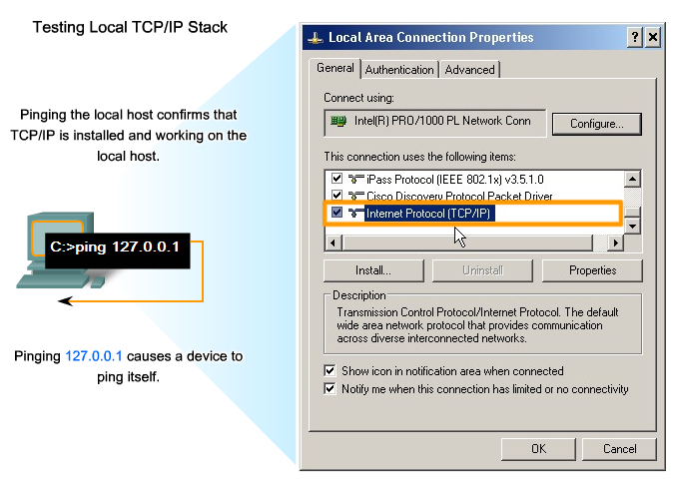
Test a connectivity

Slide 13
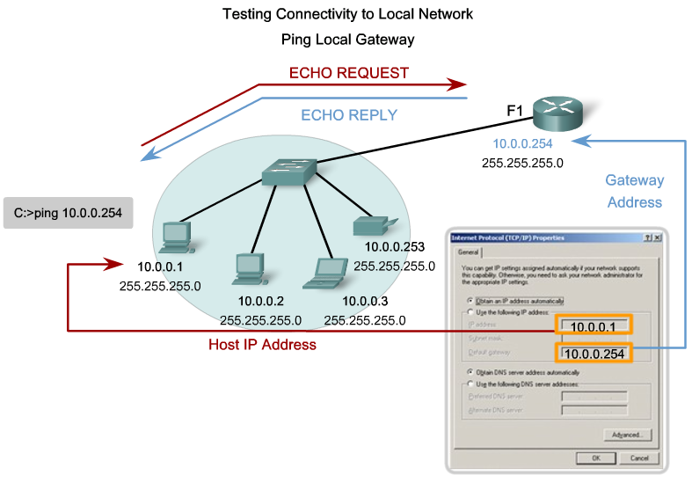
Test a connectivity

Slide 14
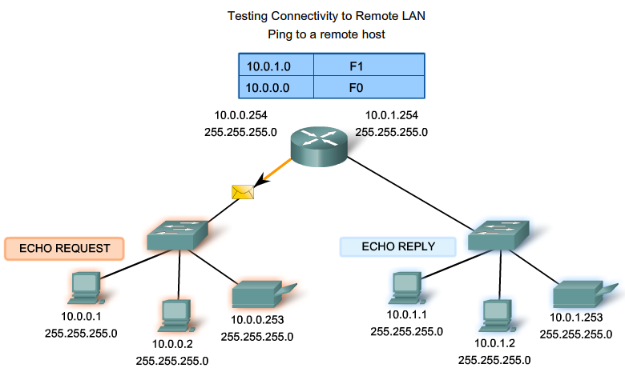
Test a connectivity

Slide 15
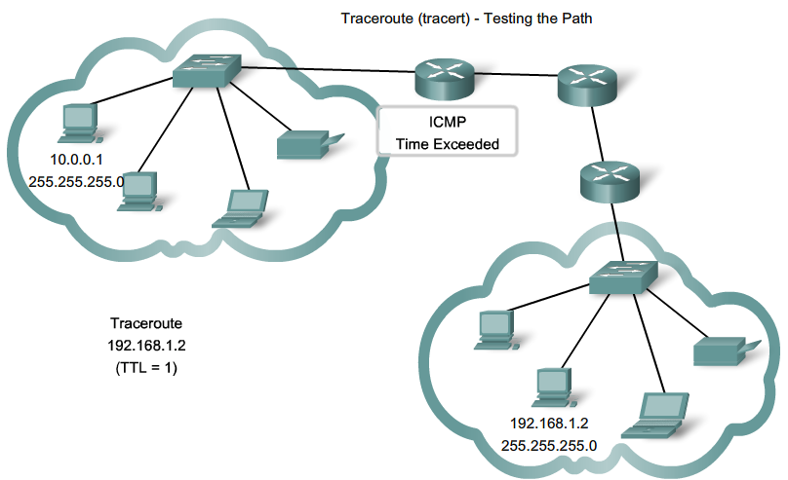
Test a connectivity

Slide 16
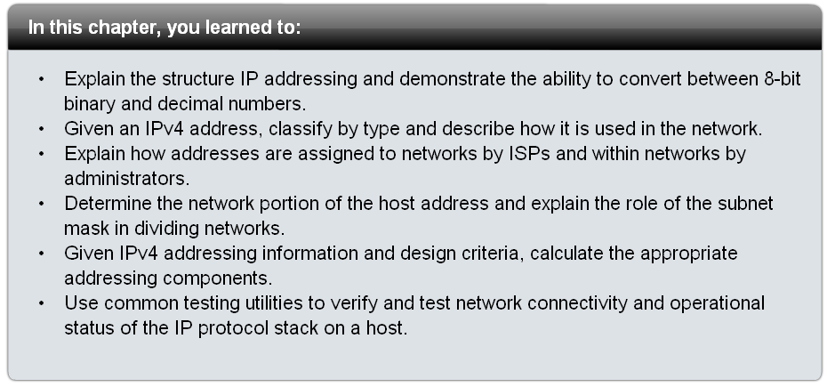
Summary

